Slide 1

Master in Artificial Intelligence and Robotics
Policy Consolidation for Continual Reinforcement Learning
Course: Reinforcement Learning
Professor: Roberto Bianco
Teacher Assistant: Michela Proietti
Students: Jacopo Tedeschi 1882789, Giordano Pagano 2077179

Slide 2


Problem :
An agent that continuously builds on its experiences to develop new skills should be able to adapt quickly while preserving the acquired knowledge.
Neural networks usually train on a stationary datasets but once the i.i.d. assumption is violated, they have been shown to suffer from catastrophic forgetting, whereby training on new data quickly erases knowledge acquired from older data.
Solution :
The proposed solution is based on Policy Consolidation model; the policy network interacts with a cascade of hidden networks that simultaneously remember the agent’s policy at a range of timescales and regularise the current policy by its own history improving its ability to learn without forgetting.This method aims to reduce the effects generated by the change in the distribution of rewards over time and the effects generated by the continuous evolution of the environment.

Slide 3
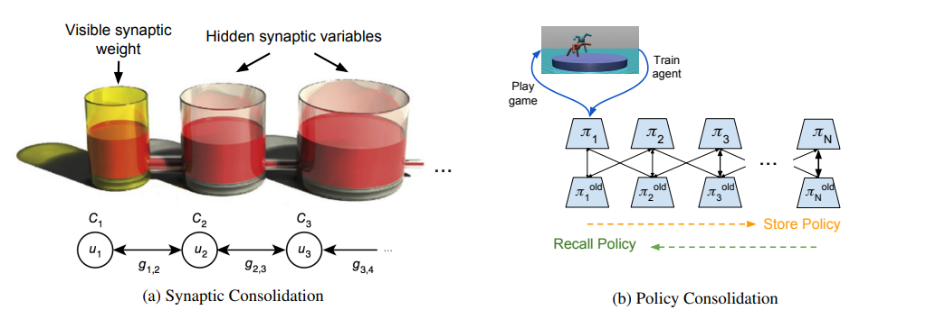
Policy Consolidation Model
The Policy Consolidation model adapts the concepts of Knowledge Distribution (arXiv:1503.02531) to the Proximal Policy Optimization (PPO) algorithm for RL (arXiv:1707.06347v2) .
Synaptic Consolidation
The Synaptic model from (arXiv:1503.02531) is describe as follow:
The level of liquid in the first beaker corresponds to the visible synaptic weight; Liquid can be added or subtracted from this beaker in accordance with any synaptic learning algorithm
Remaining beakers in the chain corresponds to the ‘hidden’ synaptic variables, which have two functions: recording the value of synaptic weight in a certain timescale, and regularizing synaptic weight in function of history, constraining the values to be close to previous values

Slide 4
The synaptic consolidation process can be formally described with a set of first-order linear differential equations, which can be translated into discrete updates with the Euler method as follows:
u1 ← u1 + η C1 (∆w + g1,2(u2 − u1))
uk ← uk + η Ck (gk−1,k(uk−1 − uk) + gk,k+1(uk+1 − uk))
where uk corresponds to the value of the kth variable in the chain (for k > 1), the gk,k+1s correspond to the tube widths, the Cks correspond to the beaker widths, ∆w corresponds to the learning update and η is the learning rate.

Slide 5


Now let apply this model to the parameters of a Neural Network, so we can define a new loss function L(U) as follows:
Each Uk actually defines its own NN and thus its own policy, which we denote πk.
With this view, we propose a new loss function that replaces the Euclidean distances in parameter space, given by the ||Uk − Uk+1|| terms, with a distance in policy space between adjacent beakers:
where π = (π1, ..., πN ),
ρ1 is the state distribution induced by following policy π1 and the DKL (πk||πk+1) terms refer to the Kullback-Leibler (KL) divergence between the action distributions (given state st) of adjacent policies in the chain. In order to implement policy consolidation in a practical RL algorithm, we adapt the fixed-KL version of PPO

Slide 6

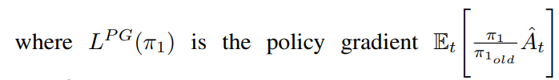
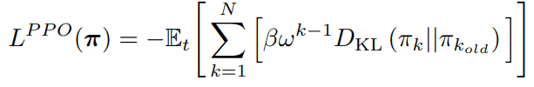
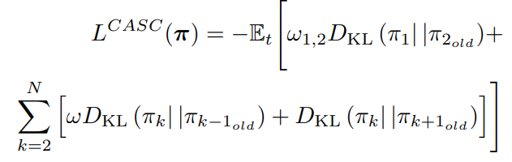
Loss Function
The final objective function for the PC model was given by:
Lppo(π) constitutes the PPO constraints that determine the timescales of the πks
and Lcasc(π) captures the KL terms between neighbouring policies in the cascade

Slide 7
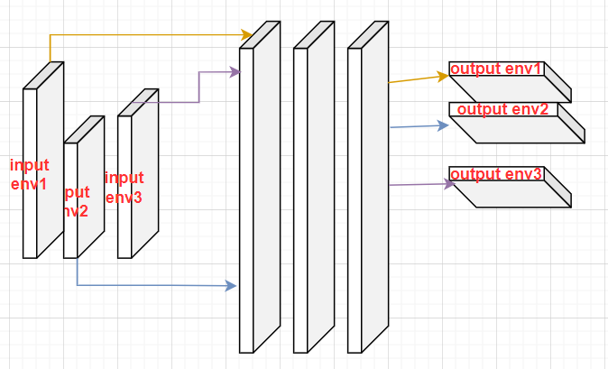
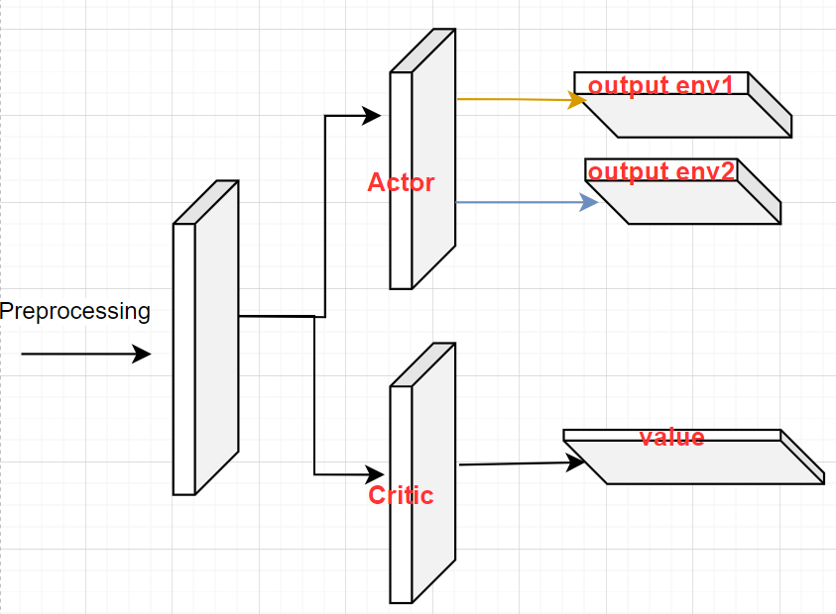
Agent Architecture
To estimate the distribution of policy we used an actor-critic architecture
Actor: the network which select the action
Critic: estimate the value of a state, used for estimate the advantage
Actor
1 linear layer with
2 output layer
Critic
1 input layer
1 output layer

Slide 8
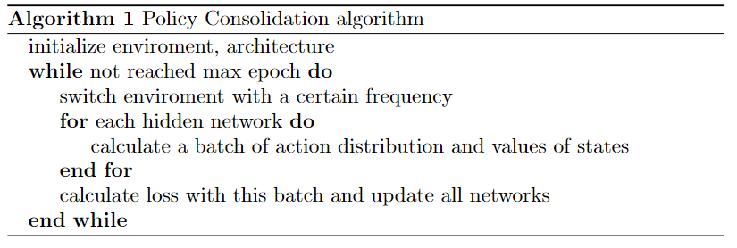
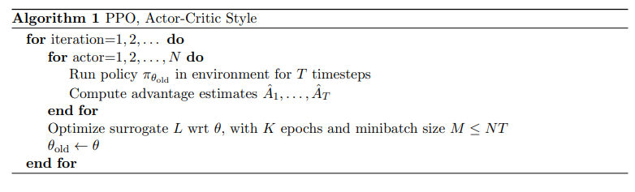
Training algorithm

Slide 9
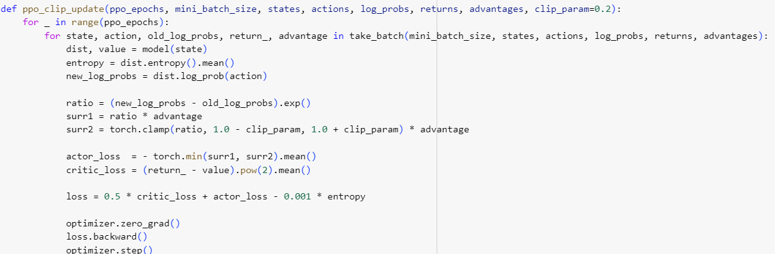
Original loss
actor_loss: maximization problem, it want to increase rewards as possible as it can
critic_loss: minimization problem, it want learn estimate correctly the value of the state

Slide 10
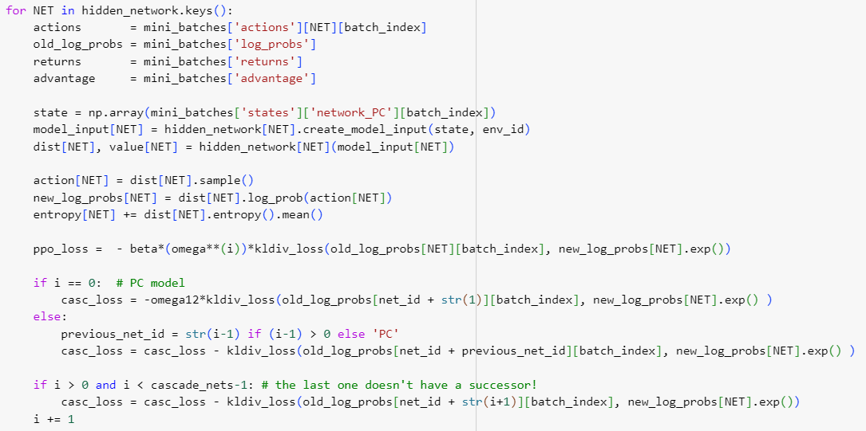
Implementation of loss

Slide 11
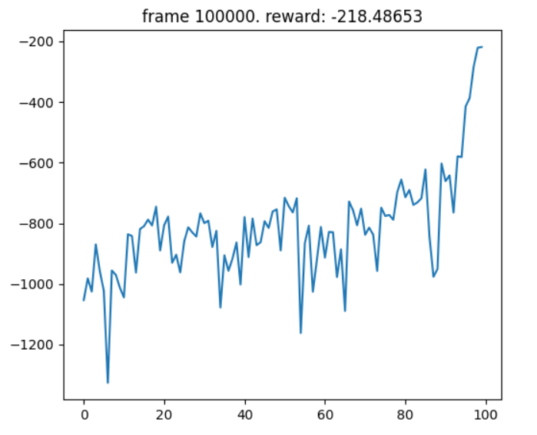
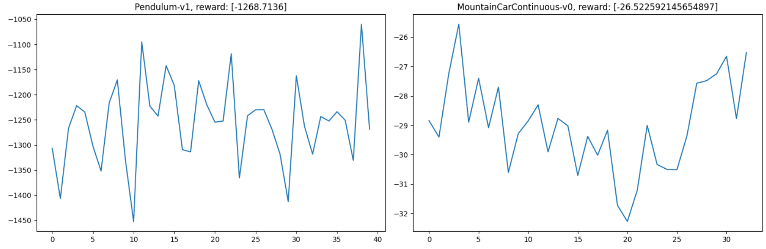
Results, problems and motivations
Old architecture: heavy computation and result too complex to estimate distributions
Original loss: easy to code and test
Old computation time: acceptable time to see result and big parallelization i.e. faster train
Actor-critic: lighter computation and easy estimation of needed values.
Final loss: hard to code
Actual computation time: slower and smaller parallelization i.e. couldn’t see results

Slide 12
References and materials
Policy consolidation: Policy Consolidation for Continual Reinforcement Learning
PPO algorithm: Proximal Policy Optimization Algorithms
GAE: high-dimensional continuous control using GAE
Slides: DIAG template for power point presentations
Images: Dall-e and Policy Consolidation for Continual Reinforcement Learning

